Slide 1
Module 5: Requirements Analysis and Modeling
Software Engineering
School of Computing, Faculty of Engineering
Universiti Teknologi Malaysia

Slide 2
Outline
Part I: Requirements Modeling Concept
  Use Case Modeling and Specification
  Domain Modeling
  Activity Diagram
  Sequence Diagram
  State Chart/State Machine Diagram
Part II: Requirements Document
  Software Requirements Specification (SRS)
Note: The overall contents of the slide are based on the main reference that is Sommerville (2016) with other references specified directly in respective slides (if any)

Slide 3
Part I: Requirements modeling concept
Use Case Modeling and Specification, Sequence Diagram, Activity Diagram, Domain Modeling, State Chart/Machine Diagram
Note: Main reference for Part I: Sommerville (2016), Arlow and Neustadt (2002)

Slide 4
Objectives
To define requirements using use cases and problem domain classes
To identify and analyze events and resulting use cases for use case diagram
To identify and analyze domain classes for domain model class diagram
To produce detail requirements using sequence diagram, activity diagram and state chart/state machine diagram

Slide 5
System Modeling
System modeling is the process of developing abstract models of a system, with each model presenting a different view or perspective of that system
System modeling represents a system using graphical notation, which is now almost always based on notations in the Unified Modeling Language (UML)
System modeling helps the analyst to understand the functionality of the system and models are used to communicate with customers

Slide 6
Existing and Planned System Models
Models of the existing system are used during requirements engineering
  They help clarify what the existing system does and can be used as a basis for discussing its strengths and weaknesses
  These then lead to requirements for the new system
Models of the new system are used during requirements engineering to help explain the proposed requirements to other system stakeholders
  Engineers use these models to discuss design proposals and to document the system for implementation

Slide 7
System Perspectives
An external perspective: model the context or environment of the system
An interaction perspective: model the interactions between a system and its environment, or between the components of a system
A structural perspective: model the organization of a system or the structure of the data that is processed by the system
A behavioral perspective: model the dynamic behavior of the system and how it responds to events

Slide 8
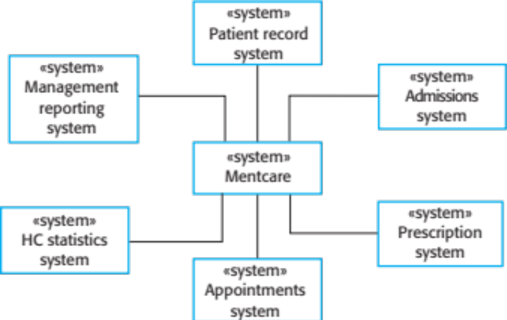
Context Model
Context models are used to illustrate the operational context of a system - they show what lies outside the system boundaries
Social and organisational concerns may affect the decision on where to position system boundaries
Architectural models show the system and its relationship with other systems
The context of Mentcare system

Slide 9
UML Diagram Types
Activity diagrams show the activities involved in a process or in data processing
Use case diagrams show the interactions between a system and its environment
Sequence diagrams show interactions between actors and the system and between system components
Class diagrams show the object classes in the system and the associations between these classes
State diagrams show how the system reacts to internal and external events

Slide 10
Use of Graphical Models
As a means of facilitating discussion about an existing or proposed system
  Incomplete and incorrect models are fine at the early stage as their role is to support discussion
As a way of documenting an existing system
  Models should be an accurate representation of the system but need not be complete
As a detailed system description that can be used to generate a system implementation
  Models have to be both correct and complete

Slide 11
Ways of Writing a System Requirements Specification
Recall
Notation | Description
Natural language | The requirements are written using numbered sentences in natural language. Each sentence should express one requirement.
Structured natural language | The requirements are written in natural language on a standard form or template. Each field provides information about an aspect of the requirement.
Design description language | This approach uses a language like a programming language, but with more abstract features to specify the requirements by defining an operational model of the system. This approach is now rarely used although it can be useful for interface specifications.
Graphical notations | Graphical models, supplemented by text annotations, are used to define the functional requirements for the system; UML use case and sequence diagrams are commonly used.
Mathematical specifications | These notations are based on mathematical concepts such as finite-state machines or sets. Although these unambiguous specifications can reduce the ambiguity in a requirements document, most customers don’t understand a formal specification. They cannot check that it represents what they want and are reluctant to accept it as a system contract.

Slide 12
Interaction model
Use Case Diagram

Slide 13
Interaction Model
Modeling user interaction is important as it helps to identify user requirements
Modeling system-to-system interaction highlights the communication problems that may arise
Modeling component interaction helps us understand if a proposed system structure is likely to deliver the required system performance and dependability
Use case diagrams and sequence diagrams may be used for interaction modeling
For the scope of this course, sequence diagrams will be discussed later under behavioural model

Slide 14
Use Case Modeling
Use cases were developed originally to support requirements elicitation and now incorporated into the UML
Each use case represents a discrete task that involves external interaction with a system
Actors in a use case may be people or other systems
Represented diagrammatically to provide an overview of the use case and in a more detailed textual form

Slide 15
Stereotypes in UML
Stereotypes allow us to introduce new modeling elements based on existing elements
Can do this by appending the stereotype name in guillemots («…») to the new element
Each model element can have at most one stereotype
Examples:
  <<include>>, <<extend>> in use case relationship
  <<entity>>, <<controller>>, <<boundary>> in class diagram as class stereotypes
  <<package>>, <<subsystem>> in package diagram

Slide 16
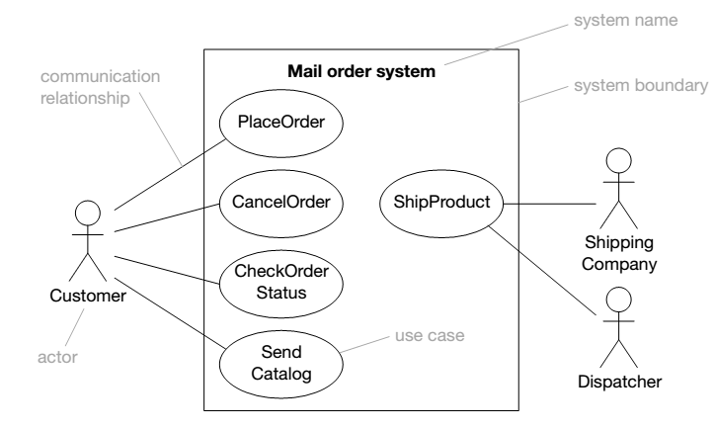
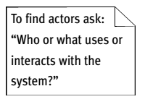
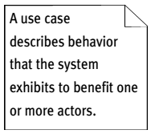
Use Case Diagram: Notation

Slide 17
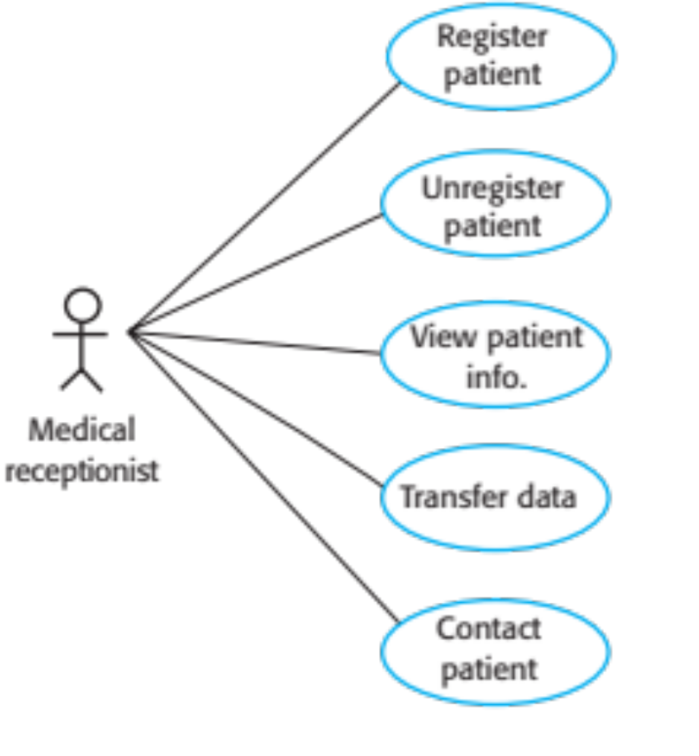
Example: Use Case Diagram for Mentcare System
Mentcare System
Note: Use cases in the Mentcare system involving the role ‘Medical Receptionist’

Slide 18
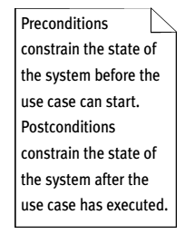
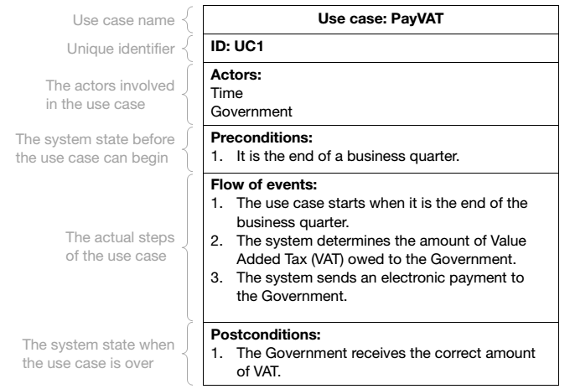
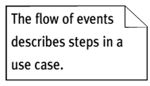
Use Case Description

Slide 19
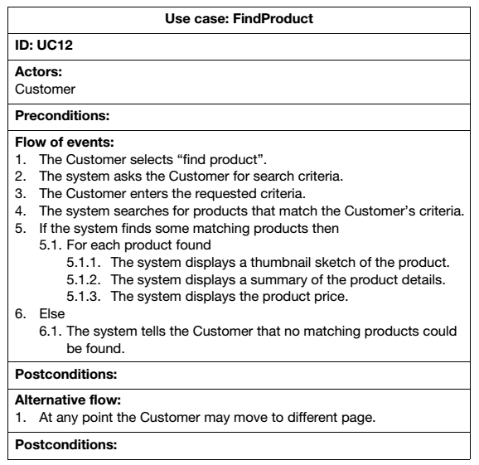
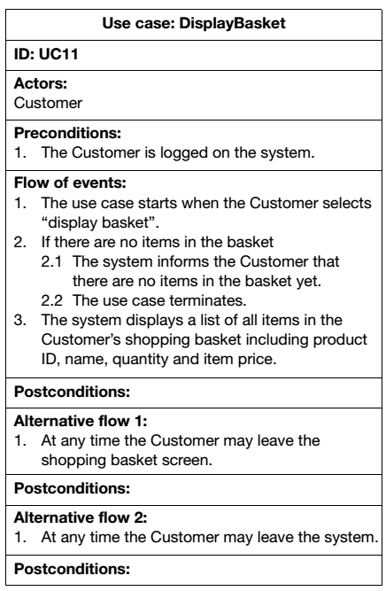
Branching within a Flow and
Alternative Flow

Slide 20
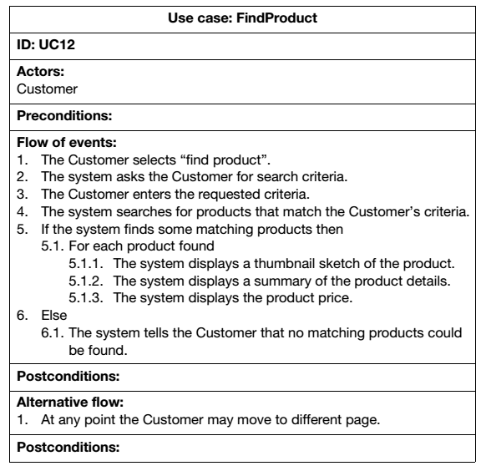
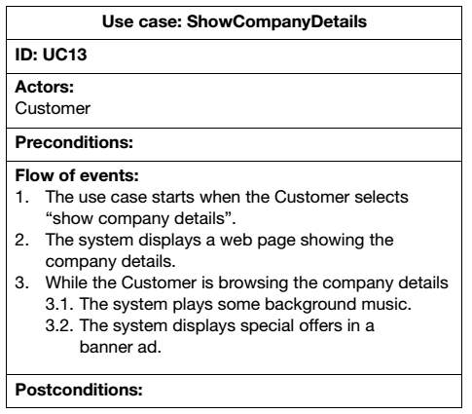
Repitition within a Flow: For/While

Slide 21
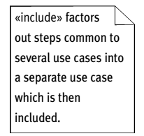
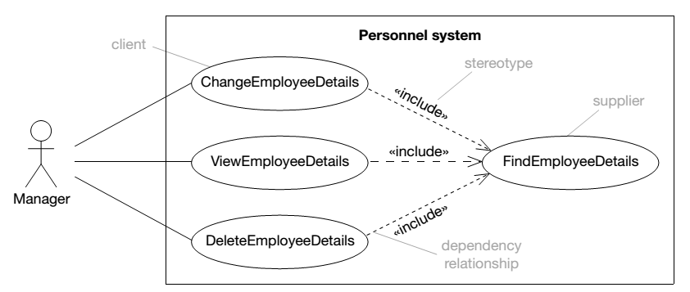
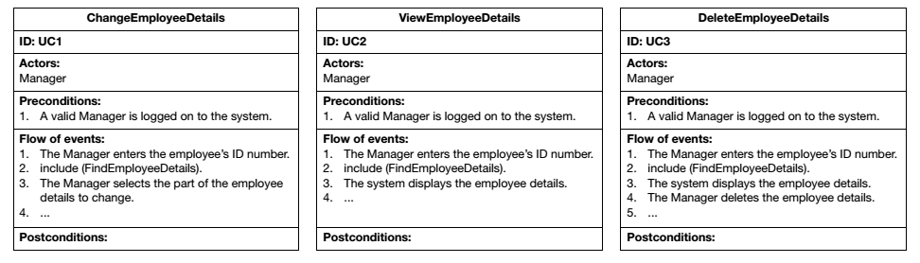
<<include>> Relationship

Slide 22
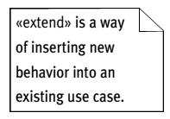
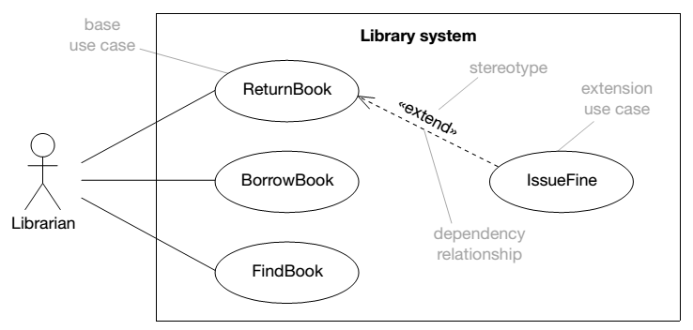
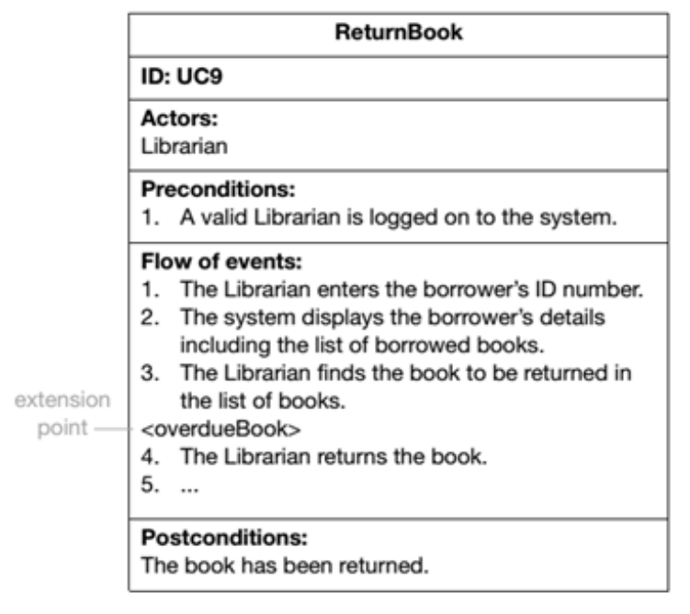
<<extend>> Relationship

Slide 23
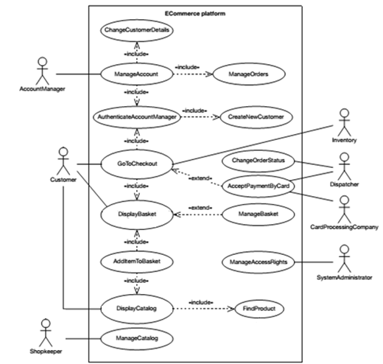
Example: Use Case Diagram for e-Commerce System

Slide 24
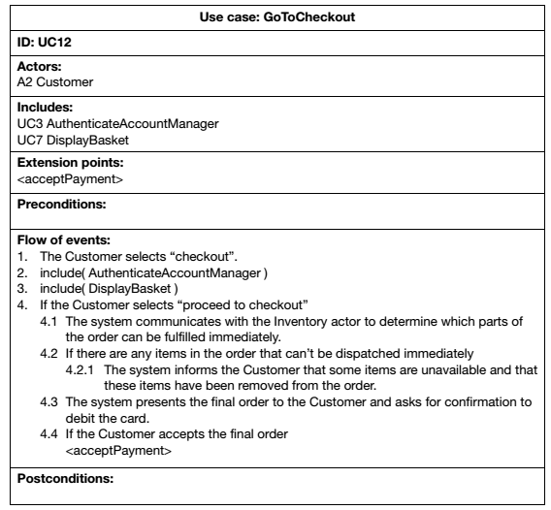
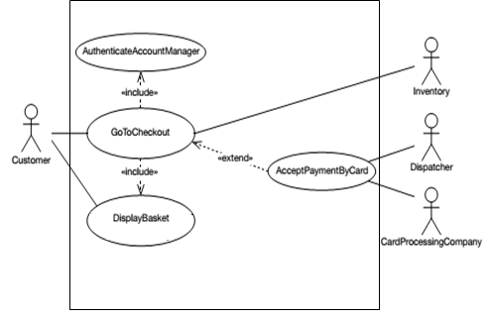
Example: Use Case Description for GoToCheckout
Note: Extension points for <<extend>> relationship can be stated before preconditions in the use case description and in the flow of events where the extension occurs

Slide 25
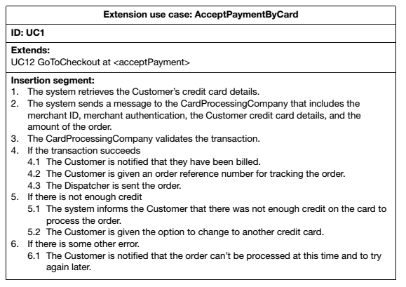
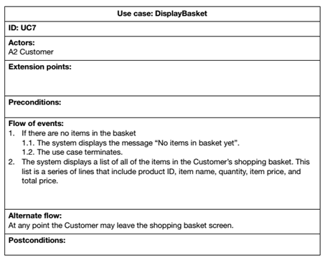
Use Case Description for AcceptPaymentByCard and DisplayBasket

Slide 26
Structural model
Class Diagram

Slide 27
Structural Models
Structural models of software display the organization of a system in terms of the components that make up that system and their relationships
Structural models may be static models, which show the structure of the system design, or dynamic models, which show the organization of the system when it is executing
Create structural models of a system when discussing and designing the system architecture

Slide 28
Class Diagrams
Class diagrams are used when developing an object-oriented system model to show the classes in a system and the associations between these classes
An object class can be thought of as a general definition of one kind of system object
An association is a link between classes that indicates that there is some relationship between these classes
When developing models during the early stages of the software engineering process, objects represent something in the real world, such as a patient, a prescription, doctor, etc.

Slide 29
Domain Model Class Diagram Notation
Class diagram key:
  General class symbol: rectangle with three sections
  Sections convey name, attributes, and behaviors
  Methods (behaviors) not shown in domain model class diagram
  Lines connecting rectangles show associations
  Multiplicity reflected above connecting lines
Domain class objects reflect business concern, policies, and constraints
When moving to design, methods and details of methods are included (design class diagram)

Slide 30
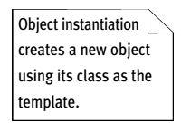
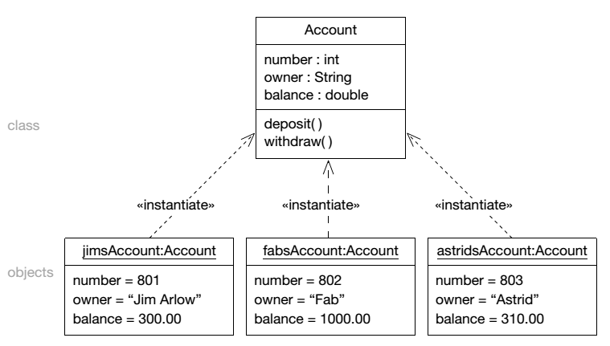
Class and Object Instantiation

Slide 31
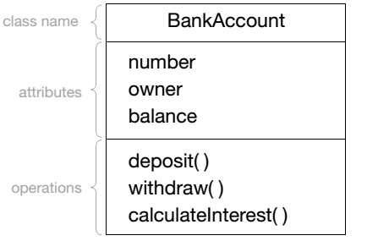
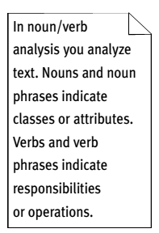
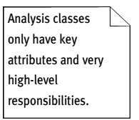
Class as a Template of Objects
Note: Do not include operation part in analysis stage – only in design stage

Slide 32
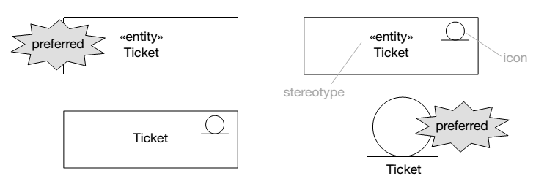
Class Stereotype Syntax

Slide 33
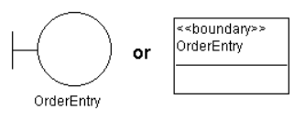
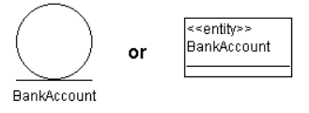
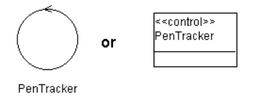
Types of Class Stereotype
Boundary class: interacts with actors outside the system and other objects in the system
Entity class: a passive class i.e. does not initiate interactions on its own, store and manage information, normally persistent data
Control class: coordinate boundary and entity object(s) – collect inform from boundary and dispatch to entity, usually has behavior specific for one use case
Source: https://www.ibm.com/support/knowledgecenter/en/SS6RBX_11.4.2/com.ibm.sa.oomethod.doc/topics

Slide 34
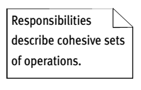
Good Analysis Class
What makes a good analysis class:
its name reflects its intent
it is a crisp abstraction that models one specific element of the problem domain
it maps on to a clearly identifiable feature of the problem domain
it has a small, well-defined set of responsibilities
it has high cohesion
it has low coupling
Note: Our SE course focuses on domain models. Thus, the concepts of high cohesion and low coupling will be elaborated in design stage where we include operations in class diagram.

Slide 35
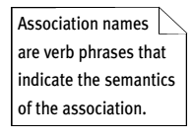
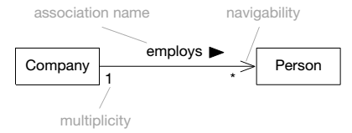
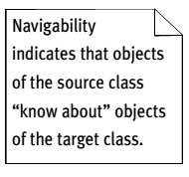
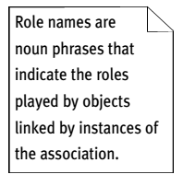
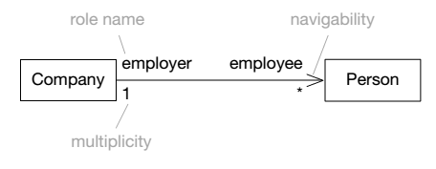
Association
Note: The arrow head in navigability can be ignored in analysis stage
OR

Slide 36
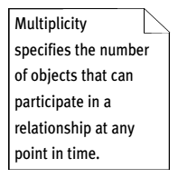
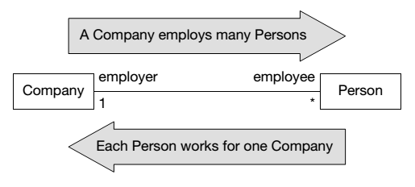
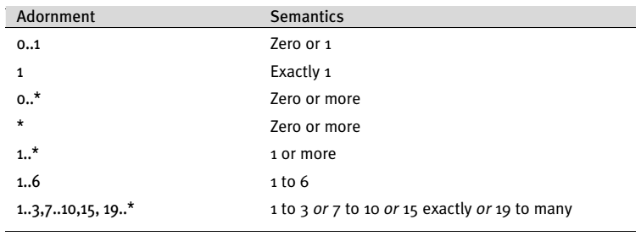
Multiplicity

Slide 37
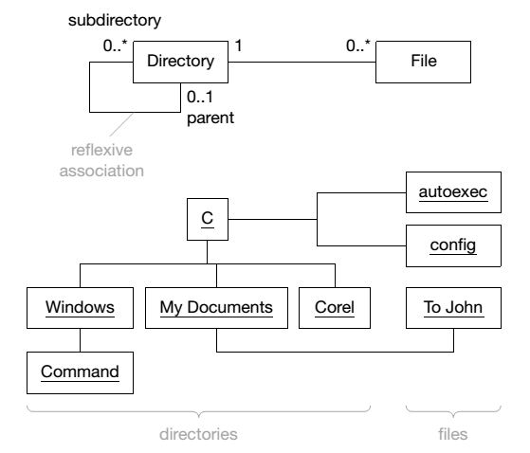
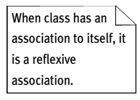
Reflexive Association

Slide 38
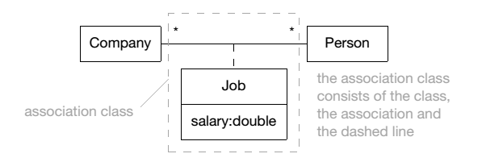
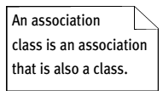
Association Class

Slide 39
Generalization…
Generalization is an everyday technique that can be used to manage complexity
Rather than learning the detailed characteristics of every entity, place these entities in more general classes (animals, cars, houses, etc.) and learn the characteristics of these classes
This allows us to infer that different members of these classes have some common characteristics e.g. square, circle and triangle are shape

Slide 40
Generalization
In modeling systems, it is often useful to examine the classes in a system to see if there is scope for generalization
Do not have to look at all classes in the system to see if they are affected by the change in future
In a generalization, the attributes and operations associated with higher-level classes are also associated with the lower-level classes
The lower-level classes are subclasses inherit the attributes and operations from their superclasses
These lower-level classes then add more specific attributes and operations

Slide 41
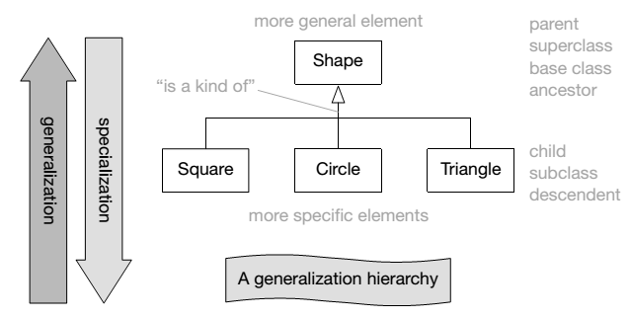
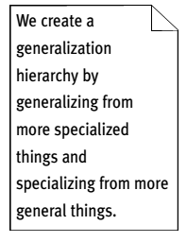
Class Generalization

Slide 42
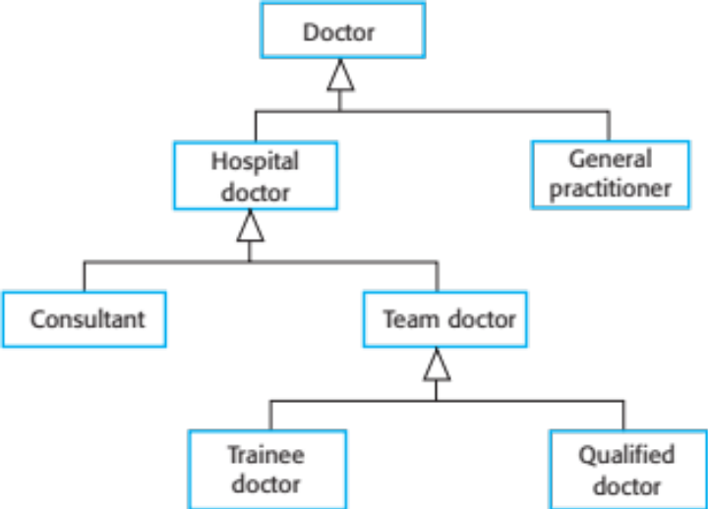
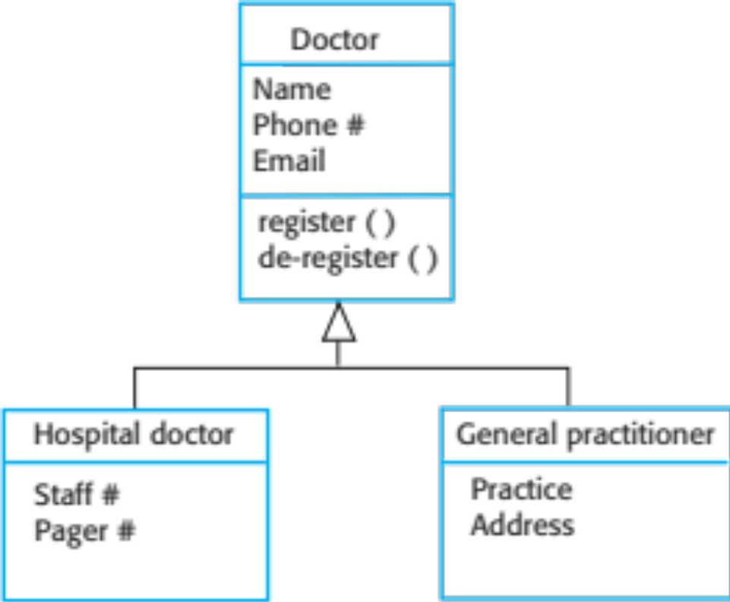
Example: Generalization Hierarchy

Slide 43
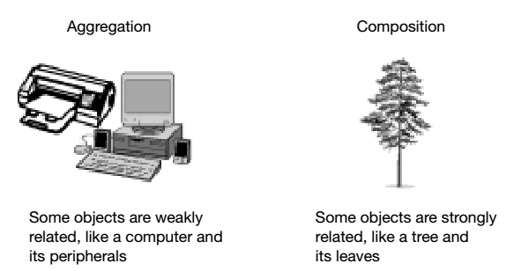




Aggregation and Composition
Note: The arrow head in navigability can be ignored in the analysis stage
Part can exist without whole
Part cannot exist without whole

Slide 44


Example: Classes and Associations in MHC-PMS

Slide 45

Example: Domain Model for Online Shopping
Note: Stating the type for the attribute is optional in analysis stage
source: https://www.uml-diagrams.org/index-examples.html

Slide 46
Behavioral model
Activity Diagram, Sequence Diagram, State Diagram (State Chart/Machine)

Slide 47
Behavioral Model
Behavioral models are models of the dynamic behavior of a system as it is executing, show what happens or what is supposed to happen when a system responds to a stimulus from its environment
Think of these stimuli as being of two types:
  Data: Some data arrives that has to be processed by the system (activity diagram, sequence diagram)
  Events: Some event happens that triggers system processing and may have associated data, although this is not always the case (state diagram)

Slide 48
Data-Driven Modeling
Many business systems are data-processing systems that are primarily driven by data, controlled by the data input to the system, with relatively little external event processing
Data-driven models show the sequence of actions involved in processing input data and generating an associated output
They are particularly useful during the analysis of requirements as they can be used to show end-to-end processing in a system

Slide 49
Activity Diagram
Activity diagrams are “OO flowcharts” that allow us to model a process as a collection of activities and transitions between those activities
Activity diagrams are really just special cases of statecharts where every state has an entry action that specifies some process or function that occurs when the state is entered
An activity diagram can be attached to any modeling element for the purpose of modeling the behavior of that element at different abstraction levels
Activity diagrams are typically attached to: use cases, classes, interfaces, components, nodes, collaborations, operations and methods

Slide 50




Activity Diagram: Transition and Decision

Slide 51


Activity Diagram: Fork and Join

Slide 52


Activity Diagram: Swimlanes

Slide 53
Sequence Diagram
Sequence diagrams are part of the UML and are used to model the interactions between the actors and the objects showing their behavior within a system
A sequence diagram shows the sequence of interactions that take place during a particular use case or use case instance (scenario)
The objects and actors involved are listed along the top of the diagram, with a dotted line drawn vertically from these
Interactions between objects are indicated by annotated arrows

Slide 54



Sequence Diagram Syntax
Note: Related Use Case Description

Slide 55
Syntax/Notation Details
Lifeline represents an individual participant (or object) in the interaction
Focus of control (activation) specifies a behavior or interaction within the lifeline also known as execution specification
Message defines a particular communication between lifelines of an interaction
Examples of communication: raising a signal, invoking an operation, creating or destroying an instance

Slide 56
Types of Message
Synchronous:
  If a caller sends a synchronous message (in sequence), it must wait until the message is done before it proceeds with its business
Asynchronous:
  If a caller sends an asynchronous message, it can continue processing and does not have to wait for a response
  Usually used in multithreaded applications and in message-oriented middleware
Return message:
  Return messages are an optional part of a sequence diagram
  The use of return messages depends on the level of detail/abstraction that is being modeled
  Return messages are useful if finer detail is required; otherwise, the invocation message is sufficient
  (Source: https://www.ibm.com/developerworks/rational/library/3101.html)

Slide 57


Message in Sequence Diagram
To show an object (lifeline) sending a message to another object, draw a line to the receiving object with a solid arrowhead (if a synchronous call operation) or with a stick arrowhead (if an asynchronous signal).
Besides message calls, there are return messages. These return messages are optional; a return message is drawn as a dotted line with an open arrowhead back to the originating lifeline, and above this dotted line you place the return value from the operation.
Source: https://www.ibm.com/developerworks/rational/library/3101.html
Source: Arlow and Neustadt (2002)

Slide 58


Iteration in Sequence Diagram
guard

Slide 59


Branching and Self-Delegation

Slide 60

Concurrency: Active Objects
asynchronous flow

Slide 61


Example: Sequence Diagram for View Patient Info in MHC-PMS
alt: Alternative flow

Slide 62

Example: Sequence Diagram for Process Order
argument
Note: Sequence diagram also shows the interaction (interaction model) besides behaviour – in the analysis stage, the argument can be included (optional)

Slide 63

Example: Sequence Diagram Using Class Stereotypes
Note: Sequence diagram with return messages (optional) using class stereotypes (optional)

Slide 64

Sequence Diagram: Scope for Analysis
Each use case must have at least one sequence diagram that comprises normal flow and alternative flows – split only if it is cluttered to combine all
Refer to use case description when creating a sequence diagram
Focus on object interaction in domain model (class diagram for analysis) for a particular use case
Not necessary to include boundary, controller and data layer that could be added in design stage

Slide 65
Event-Driven Modeling
Some systems mainly real-time systems are often event-driven, with minimal data processing
Examples: (Source: https://www.bbconsult.co.uk/blog/event-driven-applications)
  A robot has reached its destination (real-time warehouse management)
  An illegal trade pattern has been detected (fraud detection)
  A loan application has been accepted/rejected (commercial business)
Event-driven modeling shows how a system responds to external and internal events; is based on the assumption that a system has a finite number of states and the events (stimuli) may cause a transition from one state to another

Slide 66
State Chart or State Machine Diagram
In OO approaches, state chart is drawn for a single class to show the lifetime behavior of a single object
State chart is also known as state machine diagram
State: a condition during the life of an object when it satisfies some conditions, performs some actions, or waits for an event
  It is found by examining the attributes and links defined for the object
  represented as a rectangle with rounded corners
Transition: represents a change of the internal condition/state of an object

Slide 67




Event and State

Slide 68



State Syntax

Slide 69
State
State: a semantically significant condition of an object
Object state is determined by object attribute values, relationships to other objects, activities the object is performing
State syntax:
  entry action: performed immediately on entry to the state
  exit action: performed immediately on exit from the state
  internal transitions: these are caused by events that are not significant enough to warrant a transition to a new state, the event is processed by an internal transition within the state
  internal activity: a piece of work that takes a finite amount of time and which may be interrupted

Slide 70
Identifying the Object Behavior
In brief, a state in a state chart similar to status condition:
  Spans many business events
  Developed for complex problem domain classes
State chart/state machine diagram
  Composed of ovals representing status of object
  Arrows represent transitions

Slide 71
Identify States
Guidelines to help identify states:
  Check naming convention for status conditions
  Simple states reflect simple conditions such as “On”
  Complex states labeled with gerunds or verb phrases
    Example: “Being shipped”
  Active states usually not labeled with nouns
  Describe only states of being of the object itself
  Status conditions reported to management/customers
    Example: “Shipped”

Slide 72


Transition
Transitions have a simple syntax that may be used for external transitions (shown by an arrow) or internal transitions (nested within a state).
Every transition has three optional elements:
  an event – this is an external or internal occurrence that triggers the transition
  a guard condition – this is a Boolean expression that must evaluate to true before the transition can occur
  an action – this is a piece of work associated with the transition, and occurs when the transition fires

Slide 73


Event
UML defines an event as, “the specification of a noteworthy occurrence that has location in time and space.”
Events trigger transitions in state machines
Events may be shown externally on transitions
There are four types of event, each of which has different semantics:
  call event
  signal event
  change event
  time event

Slide 74


Example: Call Event State Chart

Slide 75



Example: Signal Event State Chart
Note: A state chart relates to the class that provides the signal e.g. OverdrawnAccount that triggers respective event and action

Slide 76

Example: Change Event State Chart

Slide 77


Example: Time Event State Chart

Slide 78

Example: State Diagram of a Microwave Oven

Slide 79

Example: Microwave Oven Operation

Slide 80
Rules for Developing State Charts
Select the classes that will require state charts
List all the status conditions for each group
Specify transitions that cause object to leave the identified state
Sequence state-transition combinations in correct order
Identify concurrent paths (if any)
Look for additional transitions
Expand each transition as appropriate
Review and test each state chart

Slide 81
Key Points…
A model is an abstract view of a system that ignores system details. Complementary system models can be developed to show the system’s context, interactions, structure and behavior.
Context models show how a system that is being modeled is positioned in an environment with other systems and processes.
Use case diagrams and sequence diagrams are used to describe the interactions between users and systems in the system being designed. Use cases describe interactions between a system and external actors; sequence diagrams add more information to these by showing interactions between system objects.

Slide 82
Key Points
Structural models show the organization and architecture of a system. Class diagrams are used to define the static structure of classes in a system and their associations.
Behavioral models are used to describe the dynamic behavior of an executing system. This behavior can be modeled from the perspective of the data processed by the system, or by the events that stimulate responses from a system.
Activity diagrams may be used to model the processing of data, where each activity represents one process step.
State diagrams are used to model a system’s behavior in response to internal or external events.

Slide 83
PART II: requirements document
Software Requirements Specification (SRS)

Slide 84
Objective
To understand how requirements may be organized in a software requirements document
To adopt a standard in producing a requirements document
To focus on specific requirements that include the analysis models

Slide 85
Software Requirements Document
Software requirements document is an official statement of what is required for the reference of software developers
Should include both definitions of user requirements and specifications of the system requirements
It is NOT a design document
As far as possible, it should set WHAT the system should do rather than HOW it should do it

Slide 86

User and System Requirements
Recall

Slide 87

Users of a Requirements Document

Slide 88
Requirements Document Variability
Information in requirements document depends on type of system and the approach used in its development
Systems developed incrementally will, typically, have less detail in the requirements document
Requirements documents standards have been designed e.g. IEEE standard
These are mostly applicable to the requirements for large software projects

Slide 89

IEEE Std 830-1998

Slide 90

SRS Outline of IEEE Std 830-1998
See page 11 of IEEE Std 830-1998

Slide 91

Example of Template for the Front Part of SRS Document

Slide 92

Section 1: Introduction

Slide 93

Section 2: Overall Description,
Sub-Section 2.1

Slide 94

Sub-sections 2.1.1 to 2.1.3

Slide 95

Sub-sections 2.2 & 2.3

Slide 96

Sub-sections 2.4 to 2.6

Slide 97

Section 3: Specific Requirements
Note: Focus on “Specific Requirements” for the scope of this course – see the given System Documentation template that combines the required details for analysis (Section 2), design (Section 3 to 6) and testing (Section 7 and 8) to meet the minimum requirements of this course

Slide 98

Appendix A.5 Template of SRS Section 3: Organized by Feature (IEEE Std 830-1998)
Sections 3.1.1 to 3.1.4 provide the details of what described in Sections 2.1.2 to 2.1.5
For each functional requirement, include the use case diagram and its details using use case description
Include sequence diagram and activity diagram for each use case i.e. functional requirement
Include state diagram for classes with states under respective use cases
Our Focus

Slide 99
Key Points
The software requirements document is an agreed statement of the system requirements
It should be organized so that both system customers or users and software developers can use it
Documentation standard can be referred and customized based on stakeholders’ needs

